Slide 1
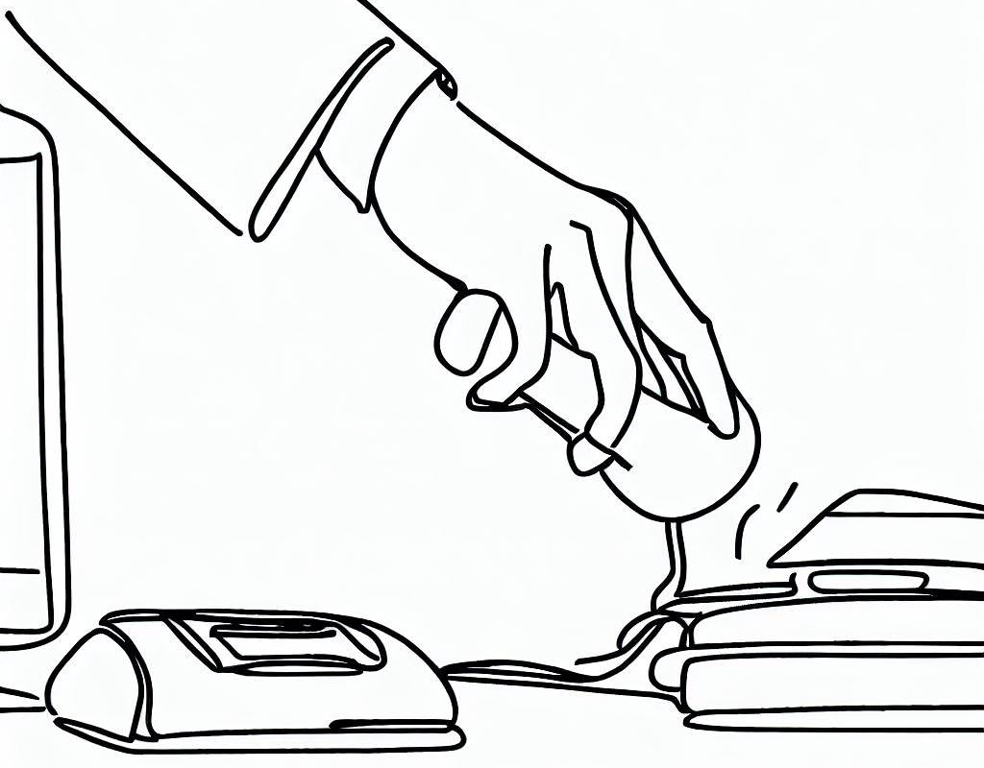
Slide 1 Opening
Audio Narration | Slide Mockup
Welcome to the Effective Business Phone Etiquette Training Course. In this course, we will explore essential skills and strategies to handle phone calls with confidence and professionalism. Throughout the modules, we will focus on key areas such as greeting callers, active listening, providing accurate information, problem resolution, and effective call closing. By the end of this course, you will be equipped with the knowledge and techniques to excel in business phone etiquette and deliver exceptional customer service. Let's get started on this journey of enhancing your phone communication skills. | Use this space to create a mockup of the slide. Display content of the course.
Interactivity & Programing Notes
Display content of the course. Allow the learner to click on the highlighted text to proceed to the next slide.
Content
…
Next

Slide 2
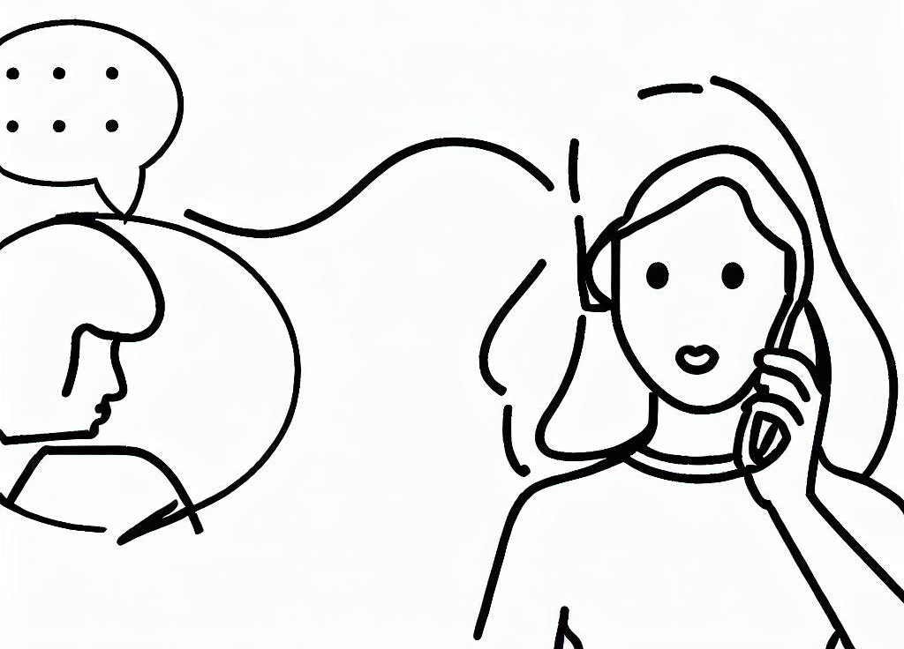
Slide 2 Greeting
Audio Narration | Slide Mockup
Greeting the caller in a prompt and friendly manner is vital because it sets the tone for the entire conversation and creates a positive first impression. Let’s explore further. | Use this space to create a mockup of the slide. Display a visual representation of a person answering a phone call, with a speech bubble showing "Hello, thank you for calling [Company Name]." Gradually transition the speech bubble text to show "This is [Your Name] speaking. How may I assist you today?" Text on the slide can include a heading such as "Greeting" and additional text describing the importance of a professional greeting and tips on how to prepare, such as "Answer calls within the first 3 rings," "Use a warm and friendly tone," and "Identify yourself and the company clearly."
Interactivity & Programing Notes
Display an animated illustration of a person answering a phone call. Upon clicking, play an audio clip of a ringing phone. Trigger the animation of the person picking up the phone when the audio clip ends. Display text on the slide that highlights the importance of a professional greeting. Followed by tips on how to prepare. Allow the learner to click on the highlighted text to proceed to the next slide.
Tips
…
Next

Slide 3
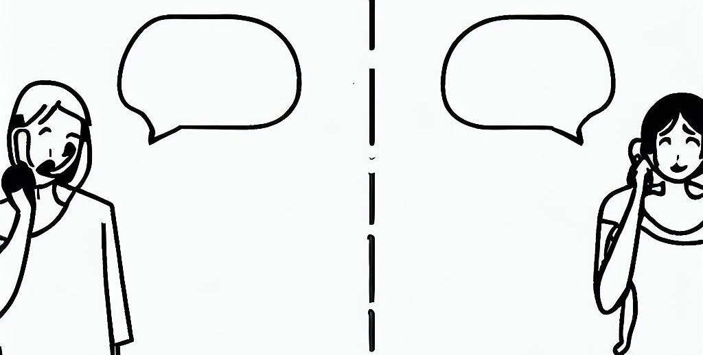
Slide 3 Active Listening
Audio Narration | Slide Mockup
Next, we will explore the key skills and strategies to handle phone calls with confidence and professionalism. One vital skill is active listening, which allows you to fully understand and address the caller's needs. | Display a visual representation of a person engaged in a phone conversation, leaning forward attentively. Text on the slide can include a heading such as "Active Listening" and additional text describing the importance of active listening and tips for effective active listening: Focus on the caller's words: Pay close attention to what the caller is saying without interrupting. Ask clarifying questions: Seek clarification to ensure a thorough understanding of the caller's needs. Paraphrase to demonstrate understanding: Summarize or rephrase the caller's statements to show that you have actively listened and understood their message. Caller: Hi, I'm having trouble with my account. I made a payment, but it's not reflecting on my statement. Employee: Thank you for reaching out to us. I understand that you made a payment, but it's not showing up on your statement. Let me investigate this for you. Can you please provide me with the date and amount of the payment? Caller: Sure, I made the payment last week on Tuesday, and it was for $100. Employee: Thank you for sharing that information. Just to clarify, you made a payment of $100 last Tuesday, and it's not appearing on your statement. Is that correct? Caller: Yes, that's correct. I'm concerned because I don't want to incur any late fees.
Interactivity & Programing Notes
Display an animated illustration of a person engaged in a phone conversation, leaning forward attentively. Upon clicking, play an audio clip of a phone conversation to simulate a realistic experience. Display text on the slide that highlights the importance of active listening and provides tips for effective active listening. Allow the learner to click on the highlighted text to proceed to the next slide.
Tips
…
Next

Slide 4

Slide 4 Providing Information/Assistance
Audio Narration | Slide Mockup
This step involves providing accurate and relevant information or assistance to customers. Let's dive in! | Display a visual representation of an employee using a computer or CRM software to access customer information. The employee should be shown engaging in a conversation with the customer on the phone. Text on the slide can include a heading such as "Providing Information/Assistance" and additional text explaining the performance standard, tools, required knowledge, concerns (if applicable), and desired worker behavior. CSR: Thank you for reaching out. I can definitely assist you with that. To avoid future instances of missed payments, we have a convenient service called AutoPay. With AutoPay, your payments can be automatically deducted from your registered bank account or credit card, ensuring you never miss a payment. Would you like me to set up AutoPay for you? Caller: Yes, that sounds like a helpful service. Please set it up for me. CSR: Great! I will need some information from you to get started. Could you please provide me with your bank account details or credit card information? Rest assured that our system is secure and your information will be handled with utmost confidentiality.
Interactivity & Programing Notes
Display an animated illustration of an employee using a computer or CRM software to access customer information. Upon clicking, play an audio clip of a customer inquiry or concern. Display text on the slide that explains the performance standard, tools, required knowledge, concerns (if applicable), and desired worker behavior. Allow the learner to click on the highlighted text to proceed to the next slide.
Providing Information/ Assistance.
…
Next

Slide 5
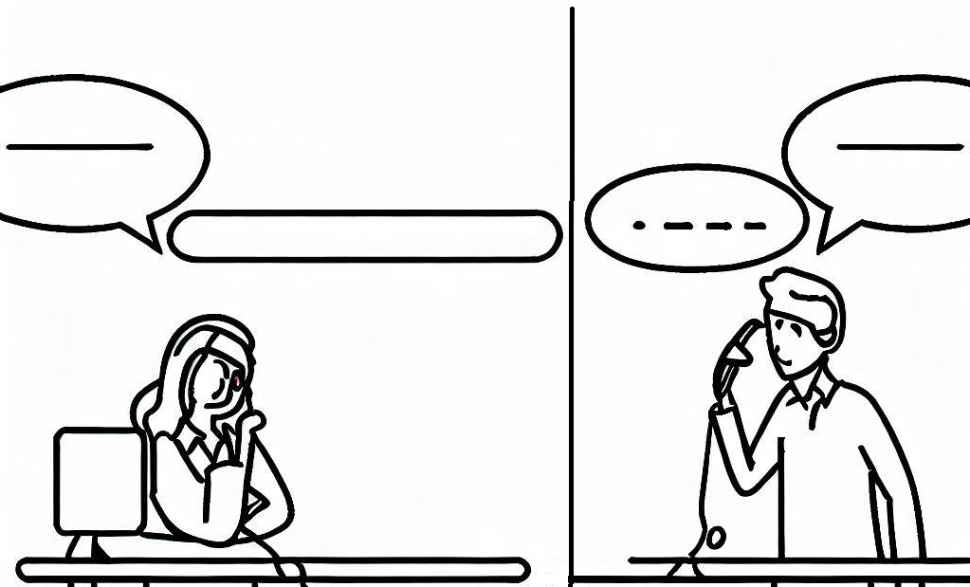
Slide 5 Problem Resolution
Audio Narration | Slide Mockup
In this step, we will explore how to handle challenging or difficult calls calmly and effectively, ensuring that customer issues are resolved to their satisfaction. | Display a visual representation of an employee on the phone, demonstrating a calm and composed demeanor while addressing a challenging customer concern. Text on the slide can include a heading such as "Problem Resolution" and additional text explaining the performance standard, tools, required knowledge, concerns, and desired worker behavior. Customer: Hi Sarah, I'm James, and I'm having an issue with my payment. I made a payment last week, but it doesn't seem to have gone through, and I received a payment reminder today. CSR: I apologize for the inconvenience, James. Let me check the details of your payment. Could you please provide me with your account number or any other identifying information? Customer: Sure, my account number is 123456789. CSR: Thank you, James. Let me look that up for you. I see that the payment you made last week wasn't successfully processed due to an error in the transaction. I apologize for the oversight. We'll get this sorted out for you right away. Customer: Thank you, Sarah. I appreciate your help. What should I do next? CSR: To resolve this issue, I'll need to update your payment information and process the payment again. Can you please confirm the payment method you'd like to use and provide the necessary details? Customer: I'll be using my Visa credit card. The card number is 1234 5678 9012 3456, and the expiration date is 08/25. CSR: Thank you, James. I've updated your payment method with the provided details. I'll now process the payment, and you should receive a confirmation shortly. Is there anything else I can assist you with?
Interactivity & Programing Notes
Display an animated illustration of an employee engaging in a conversation with a challenging customer. Upon clicking, play an audio clip of a challenging customer inquiry or concern. Display text on the slide that explains the performance standard, tools, required knowledge, concerns, and desired worker behavior. Allow the learner to click on the highlighted text to proceed to the next slide.
Problem Resolution
…
Next

Slide 6
Slide 6 Closing
Audio Narration | Slide Mockup
The final step is closing and it involves closing the call with a summary, confirming any agreed-upon actions, and expressing gratitude. Let's proceed!] | Display a visual representation of an employee ending a phone call with a customer. The employee should be shown with a polite and professional demeanor, expressing gratitude. Text on the slide can include a heading such as "Closing" and additional text explaining the performance standard, tools (none required for this step), required knowledge, concerns (if applicable), and desired worker behavior. Customer: Thank you so much for your understanding and assistance, Sarah. I genuinely appreciate it. Is there anything else I need to do to rectify the situation? Customer Service: You're welcome, Mr. Smith. I'm glad I could help. To ensure you're up to date, I recommend making the payment for the current month's bill as soon as possible. Additionally, I encourage you to set up automatic payments or reminders to avoid missing future due dates. This will help you stay on track with your payments. Customer: That's a great suggestion, Sarah. I will definitely set up automatic payments to avoid any future issues. Thank you for the reminder. Customer Service: You're welcome, Mr. Smith. It's always a good idea to have those reminders in place. If you have any further questions or concerns, please don't hesitate to reach out to us. We're here to assist you. Customer: I appreciate your support, Sarah. Thank you for your time and understanding. Have a wonderful day! Customer Service: You're very welcome, Mr. Smith. Thank you for choosing ABC Finance. Have a fantastic day as well! Goodbye!
Interactivity & Programing Notes
Display an animated illustration of an employee ending a phone call with a customer, expressing gratitude. Upon clicking, play an audio clip of a closing statement, summarizing the call and expressing appreciation. Display text on the slide that explains the performance standard, tools (none required for this step), required knowledge, concerns (if applicable), and desired worker behavior. Allow the learner to click on the highlighted text to proceed to the next slide.
Closing
…
Next

Slide 7
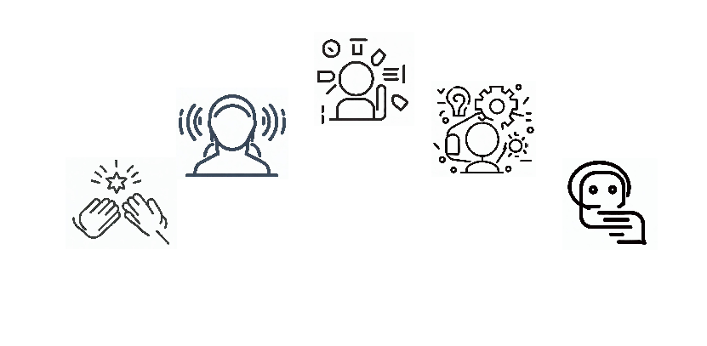
Slide 7 Closing
Audio Narration | Slide Mockup
Congratulations on completing the Effective Business Phone Etiquette Training Module! Throughout this training, we explored essential skills and strategies for handling phone calls with professionalism and effectiveness. Let's recap the key steps we covered together. | Display visual representations of the five steps of the Effective Business Phone Etiquette: Greeting, Active Listening, Providing Information/Assistance, Problem Resolution, and Closing. Text on the slide can include headings for each step, along with a summary of the performance standard, tools, required knowledge, concerns, and desired worker behavior. Key Takeaways: Greeting: Answer calls promptly and greet the caller in a professional and friendly manner within the first three rings. Active Listening: Demonstrate active listening skills by fully focusing on the caller's needs and providing appropriate responses. Providing Information/Assistance: Offer accurate and relevant information, address inquiries or concerns effectively. Problem Resolution: Handle challenging or difficult calls calmly and effectively, resolving customer issues to their satisfaction. Closing: Summarize the call, confirm any agreed-upon actions, end the call with professionalism and gratitude.
Interactivity & Programing Notes
Display an animated illustration representing each of the five steps covered in the module: Greeting, Active Listening, Providing Information/Assistance, Problem Resolution, and Closing. Upon clicking, play a brief audio clip summarizing the purpose and importance of each step. Display text on the slide that provides a brief summary of the performance standards, tools, required knowledge, concerns, and desired worker behaviors associated with each step. Allow the learner to click on the highlighted text to conclude the module.
Summary
…
End

